Slide 1

GITOS (GITAM OS) A PROJECT REPORT
THE ACADEMIC PROJECT
IN
COMPUTER SCIENCE AND ENGINEERING
BY
Under the guidance of D.SOHITH 2210314714
Mr.Yugandhar Garapati C SAI SATHVICK 2210314709 (M.Tech) ,Ph.D WASEEM VADLA 2210314763 Assistant Professor K RAHUL SRINIVAS 2210314750

Slide 2
Introduction
Motivation
Problem definition
Objective of Project

Slide 3
MOTIVATION
There is no Operating System which is targeted to assist Engineers.
The aim is to build an Operating System with built-in engineering tools.
The operating system will be having a lucrative graphical user interface which will in turn give a better user experience.

Slide 4
Problem Definition
There are no student centric application Operating System
Universities have to install the applications on their own costing them time.
The Purpose of GITOS is to fulfill the needs and requirements of the modern engineering students.
Irrespective of the branch we aim to provide a useful System.

Slide 5
Objective of Project
GITOS is an operating system completely for the engineers by the engineers and to the engineers.
The Purpose of GITOS to fulfill the needs and requirements of the modern engineering students.
It has all the FOSS and Proprietary Licensed Academic software and.

Slide 6
LITERATURE SURVEY
Introduction
Existing System
Disadvantages of Existing system
Proposed

Slide 7
Introduction
The advantages of GITOS are:
It works out of the box.
It's both free of cost and open source.
It's community-driven.
Based on Debian and Ubuntu.
It's safe and reliable.

Slide 8
Existing System
Presently the engineering institutions are engaged with proprietary operating system which turns to be very costly.
An engineering student oriented operating system is still not designed with all specifications required.
Existing operating systems provide variety of user interfaces but fails to satisfy present engineering student’s personal specific needs

Slide 9
Disadvantages of Existing System
1) Drivers: Finding the necessary driver can be time taking.
2) Economy: People are spending less, so a free OS is preferred.
3) Trust : Operating Systems in the market are enabling the user to compromise with their data and privacy.
4) End user resistance : Capabilities of the Linux based operating system are safer, more efficient and less vulnerable to data leak.
5) Value for money: Current systems offer very low value for specific needs of an Engineer

Slide 10
Proposed System
Advantages of GITOS are:
It works out of the box, with fully education tools, multimedia support and is extremely easy to use.
It's both free of cost and open source.
It's community-driven, Engineering students from different colleges with their ideas can be used to improve GITOS.
Based on Debian and Ubuntu, it provides about 30,000 packages including all engineering packages and one of the best software managers to install software and tools.
It's safe and reliable

Slide 11
Analysis
Software Requirement Specification
Software requirement
Hardware requirement
Flowchart

Slide 12
Software Requirement Specification
Software Requirement
Base Operating System : GNOME Linux Flavour
Working Website : SUSE Studio
Creating boot : ISO to USB
Required Tools and packages to be installed in OS

Slide 13
Hardware Requirement
Hardware :Dual Core
Speed :2 GHz
RAM :2 GB
Hard Disk :25 GB
VGA :1024x768
Drive/Port :CD or USB

Slide 14
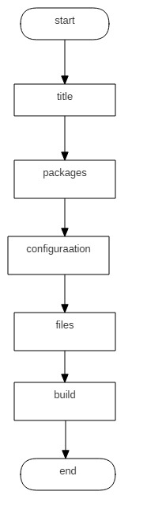
Flow Chart

Slide 15
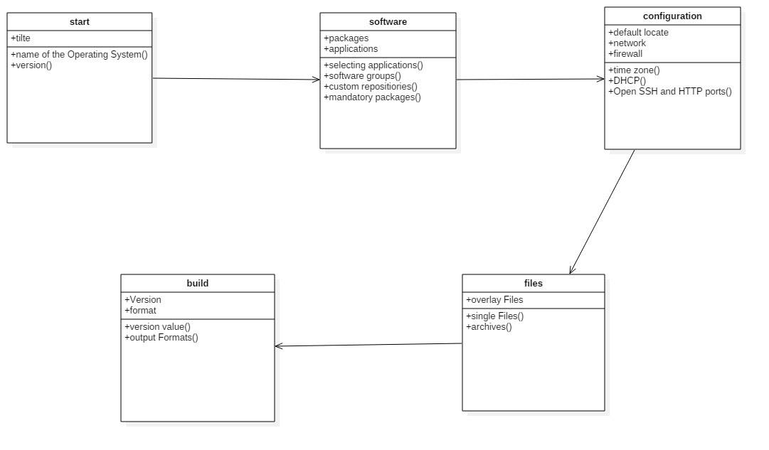
DESIGN
UML diagrams
Class Diagram:

Slide 16
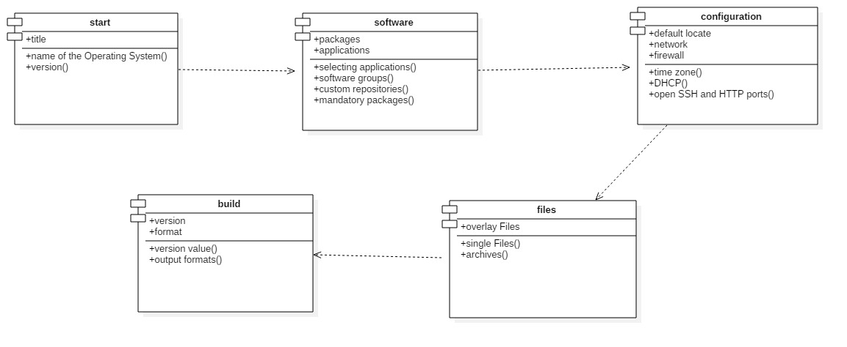
Component Diagram

Slide 17
Conclusion
As expected the designed Operating System will be more efficient and have tremendous graphical user interface which can attract large number of engineering students which will lead to the respective institutions to adapt to it easily. It can be implemented in a large scale and its availability can reduce the hefty work behind the installation of each application by the lab technicians.

